Slide 1
“Behold The Power of Us!”
Lt Gen Chris Weggeman
Deputy Commander, Air Combat Command
Notes:
.

Slide 2
ABMS, JADC2, IW, OIE, EMS, ZTA, EITaaS, ICAM, DevSecOps!!!!!!!!!!!!
EITaaS
Zero Trust
Notes:
I don’t know about you, but I could really use a break from the never ending cacophony of “IT BUZZWORD BINGO” that dominates the symposium circuit.
This morning, I intend to talk about the power BEHIND our digital enlightenment; the REAL POWER behind our digital convergence!
So everyone just take a chill pill, calm down, and find your happy place.

Slide 3
The Power of Convergence…
Convergence: (n.)
The merging of distinct technologies, industries, or devices into a unified whole
-source: Merriam-Webster.com
Wedgevergence: (n.)
The merging of distinct technologies, industries, or devices so as to not suck!
--source: Wedge
Notes:
To set the stage I first want to offer these two definitions for the concept of CONVERGENCE….what does is mean?
The first is the authoritative source for the word’s definition
The second is a word that awaits formal adoption by Merriam-Webster’s, but defines our operational imperative.
I remain cautiously optimistic on my accreditation.

Slide 4
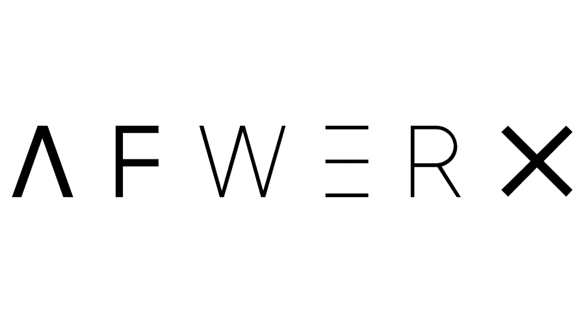
The power of Convergence lies in our People, our Digital Disruptors!
Software
Data
Innovation
JAIC-JCF for AI
Digital Univ
Unified Data Library
And a lot more…
Notes:
Within our digital enlightenment, I often talk about these three operational center’s of gravity; SOFTWARE, DATA and INNOVATION.
When you drill down into the source of powe in each—the ability to do work over time in these three core competencies, you quickly learn that it doesn’t come from our Hardware, Software of Firmware….it comes from our People….the human weapon system
People, our bold and audacious warriors are the real power behind our digital convergence; they are our Digital Disruptors!
And THEY are the focus of my presentation!

Slide 5
#DirsuptAirForce
“In a World of” renewed great-power competition…
Where we must accelerate change or lose…
There remains one constant…
The most powerful resource in our arsenal…
YOU!
Behold, The Power of Us!
Notes:
So here we go….My requests for funds to hire Don LaFontaine, the infamous voice of movie trailers was denied, so I’ll do my best to hook my audience.

Slide 6
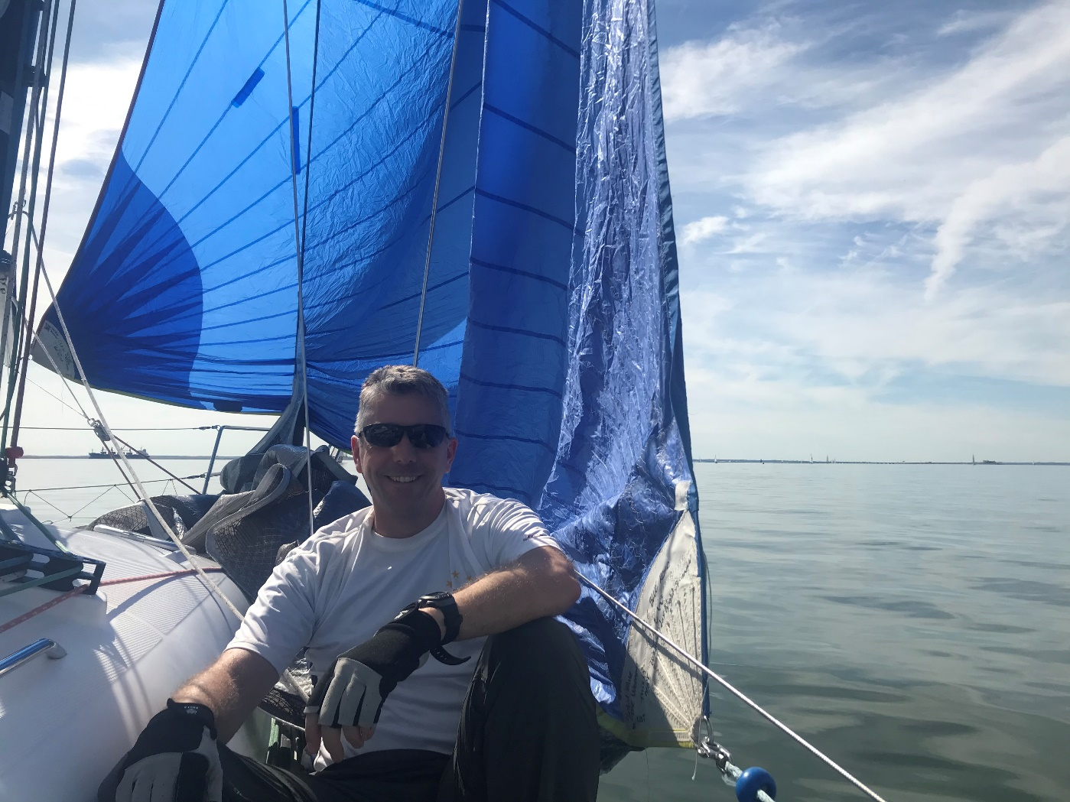
Behold the power of US…
Colonel James “Lotty” Lotspiech—KesselRun
Home Town: Smalllville TX
DIGITAL DISRUPTION: #NetworkZERO
Notes:
I would describe Col Dr Lotty Lotspiech is an Activator!...a man biased for action, for DOING. He sparked the AF Zero Trust network movement.
He Joined AF to fly jets..but Disqualified from flying at USAFA—still pursued his passion and is a licensed pilot today working on his commercial instrument rating….no one puts Lotty in the corner!
(Sail Boat- Eagle One)
Lotty is a man who was sick and tired of the ‘status qou’ of AF Network cybersecurity….He and countless others are the infamous Dutch Boy with his finger in the Dike as a thousand more leaks appeared.
Shared suffering of the 33 Network Warfare Squadron ---he realized we had 800,000 endpoints and 20,000 servers and we must NOT trust our endpoints, and build a new network for our Servers—enter NetworkZERO
Biggest obstacle is; US, we are in our own way! Probably those arrogant General Officers…Lotty believes when it comes to cybersecurity, and employing cybersecurity to drive mission success, Our culture is brittle, Inflexible, when stressed, which is daily, it breaks…our bureaucracy loves to issue cybersecurity policy, but loathes changing it. 3,000 people can say no, but only one can say YES
#1 think we can do for future success: Bias towards Action—just go do it! Learn through doing….only action will get us where we need to go.

Slide 7
Behold the power of US…
Dr. Josh Dickey —AFTAC
Home Town: Smallville FL
DIGITAL DISRUPTION: #BoxBreaker
Notes:
Dr. Josh Dickey works at the Air Force Technical Applications Center—a EE PhD with a 4.0GPA. Josh is a self professed habitual Disrupter. He delivers organizational plasticity by cross-threading technologies to do novel things….and stood up an AI/ML office at AFTAC to deliver some really cool and highly classified capabilities.
He is one of 4 kids, and between his siblings and parents/spouses…10 people, there are 10 graduate degree’s and 3 PhDs. Education is important to him/his family, but he learned early on that learning comes in many forms, that it is an intrinsic power in all of us & degrees often fail to illuminate talent
You see, his Grandfather was his biggest role model…a man with a 3rd grade education, a hero, a WWII motorcycle courier for Gen Eisenhower…he could do anything, make anything, fix anything…carpenter, electrician, general contractor….a true self taught, do-it-yourself prodigy….and Josh’s grandfather was his Yoda.
Ironically Josh hates computers. He wants them to do the mundane tasks for everyone….he seeks to ‘Free human capital with digital slave labor’
Biggest obstacle to success: the infamous tech transition…surviving the red team, posse of proctologists, defending your tech. These “detractors” actually motivate Josh to improve his idea, pitch, or his algorithm.
#1 Think we can do for future success: Collaboration and Exposure, get ‘outside of our box’! Entrenched world view is poison…..we must See what we’re all doing…we’re missing so much

Slide 8
Behold the power of US…
Captain Victoria Wyler
Home Town: Smallville Maryland
DIGITAL DISRUPTION: #QueensGambit
Hagrid #Disruptador
Notes:
Captain Victoria Wyler is digital royalty….referred to as Queen Victoria, like me, she is a digital do-er. In <90 days should put in place over $1B in contracting vehicles for people to leverage Devsecops platform and cloud services. She blazes a path to YES.
She grew up in small town Maryland, and her family emigrated to the US from Portugal. She is not a technologist, She graduated from the Air Force Academy with a degree in legal-studies.
She recently completed a tour serving as Dr. Wert’s, our PEO-Digital leader, executive assistant…..she say’s she was his “charity case” as the only non-geek on their team.
Victoria is a powerful example of the power of diversity of experience, unbridled innovation and leadership, combined with a passion for learning and growing focused on our digital enlightenment.
After observing the positive disruption and pace of change of Platform ONE, she committed herself and applied her passion for leadership and learning to drive the acquisition community towards a digitally enlightened future, so they could accelerate change and not end up losing…a better state.
She believes one of our biggest barriers to disruption is our inability to make smart and fast decisions, to break free from analysis paralysis, bias towards action, and employ a min viable product mentality rather than constantly working on the perfect, utopian end-state. As I like to say, perfection is the enemy of good enough.
She’s also a dog lover which for me, speaks volumes to her Emotional Intelligence.

Slide 9
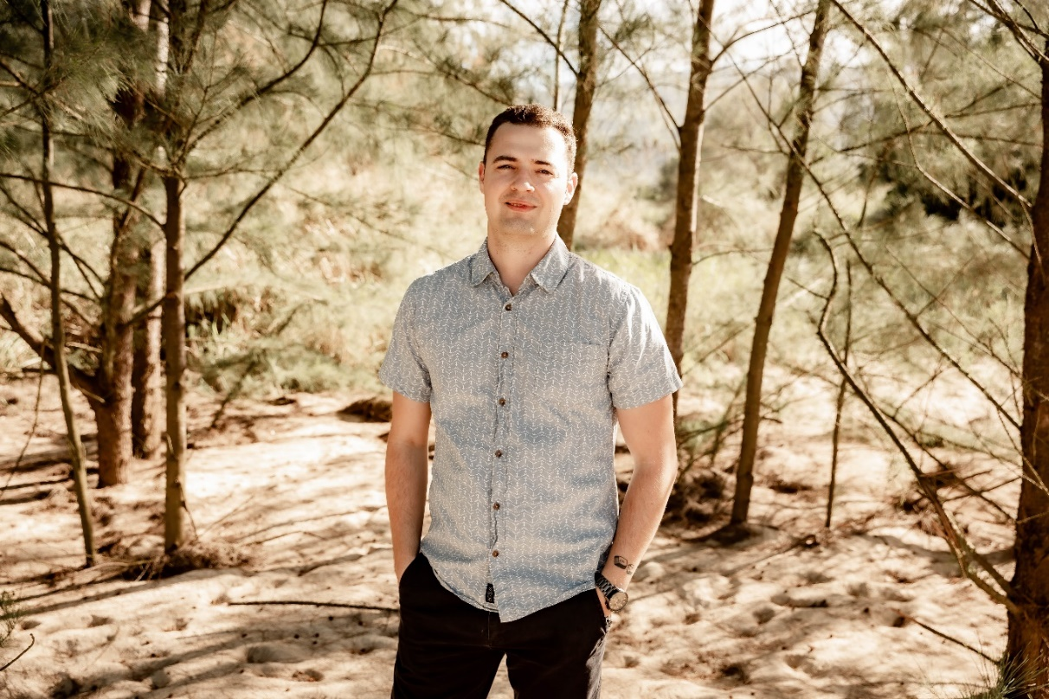
Behold the power of US…
Senior Airman Micah Johns
Home Town: Smallville KY
DIGITAL DISRUPTION: #Fruitpicker
Notes:
SrA Micah Johns, an intelligence professional is pure INSPIRATION! Josh is a low hanging fruit-picker….and a really good one. He is a data jedi who pioneered a best of breed data visualization software or “dashboards” for Intel analysts—and much much more
Oldest of 6 kids that grew up in a small town in KY with limited means. Mom was a website developer, dad was a career firefighter….throughout his formative years he learned the power of Technology, Service, and Courage….the audacity of action.
Joined the AF due to the cost of college, very excited for opportunities the AF offered in both intel and cyber career fields….aligned to his upbringing, he selected a profession that values the power of technology, Service and Courage.
He was inspired to disruption by the presence of “extreme opportunity”….an abundance of low hanging fruit across the AF missions he supported. He knows there are Airmen 1st Class in every organization that have solutions to multi-million dollar problems. Tremendous power in simple solutions which make life easier, more effective/efficient.
Two obstacles/barriers: Lack of digital competency amongst decision makers—Python (object oriented programming language) vs HTML (web page oriented language). #2: Overpromising and under-delivering—erodes trust, confidence in innovation, diverts resources
#1 thing: Improved Self awareness—are we as good as we need to be?

Slide 10
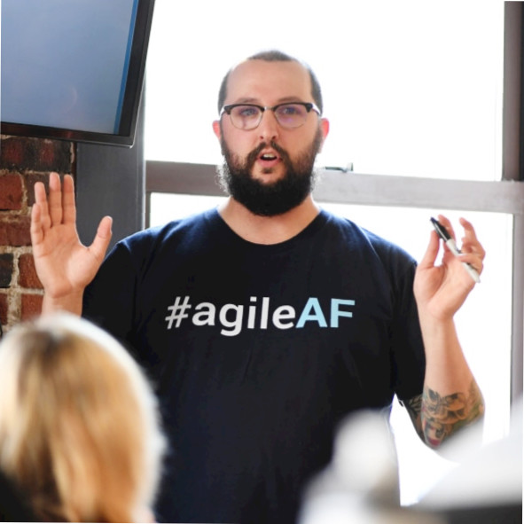
Behold the power of US…
Mr. Adam Furtado—KesselRun
Home Town: Smallville RI
DIGITAL DISRUPTION: #agile…Air Force
Notes:
Mr. Adam Furtado, one of our legendary founding fathers at KesselRun…and one of FedScoops 2021 Digital Disruptors. If you stuffed a thousand people into a still and distilled out 170 lbs of pure Customer Empathy, and then put a beard and glasses on it, you get Adam Furtado!
Grew up in small blue-collar town in Rhode Island. Graduated 187 out of 175 students in his HS class as 12 dropouts had higher GPA’s than his. So enlisted in the AF
His career began in the Air Force Honor guard---guard of honor for Pres Ford’s funeral, Obama’s inauguration, over 2,000 burials at Arlington….Adam Furtado understands Duty, Honor, and Sacrifice. This formative Air Force experience galvanized Adam’s empathy for the warfighter, their families, and ultimately the costs of freedom.
He was inspired into disruption by his multiple combat tours as a targeteer—when countless lives were on the line 24/7 each day, he said it was easier for him to communicate with his family than the warfighters on their missions.
Biggest Barrier to Disruption: The frozen middle– the bureaucracy is beating everyone down and does not value positive change...thrives in ambiguity and status quo. Lack of willingness to learn “WHY” DevSecOps matters.

Slide 11
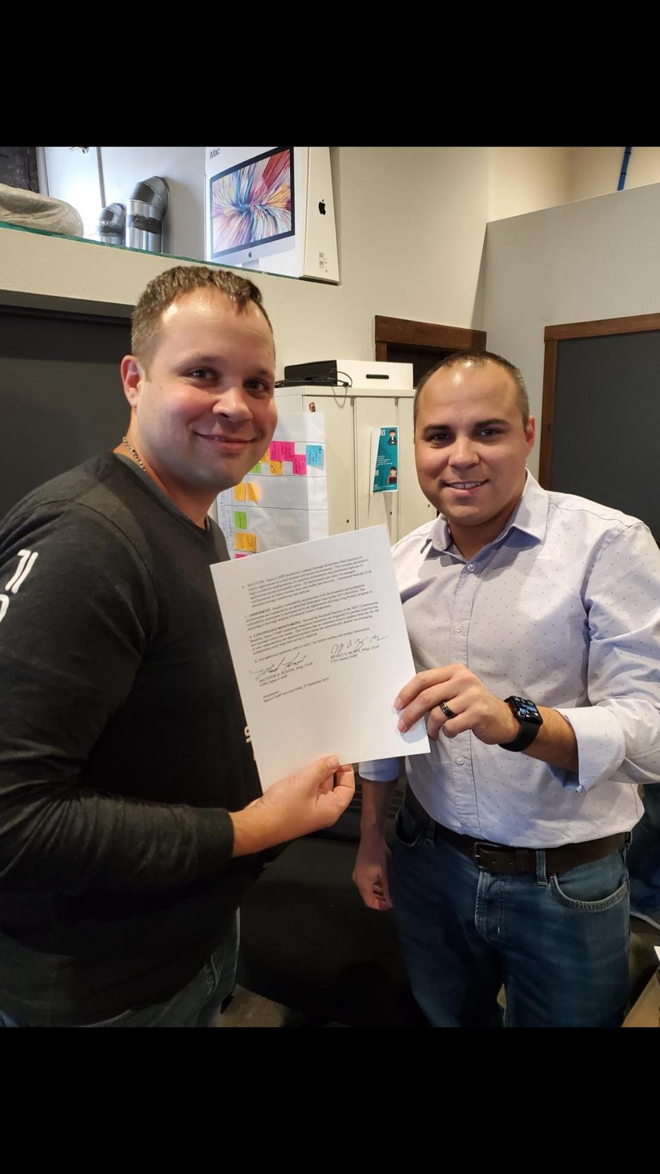
Behold the power of US…
Matt Huston & Jeff McCoy
Home Towns: Small ville USA
DIGITAL DISRUPTION: #Platformers!
Matt
Jeff
Notes:
Matt Huston and Jeff McCoy are our OG platform developers….they are our Platformers! These two are also founding fathers of Kessel Run, Platform ONE and Space Camp….both inspired into action by endless inefficiency and a void of action to accelerate change.
Matt grew up in small town OH, part of a large extended family that had very little tech in their upbringing, or his schooling, but when it comes to computers, indeed the FORCE is strong with him. He enlisted in the AF and had his Masters Degree by the time he was a Staff Sergeant. His path changed thanks to Lt Col Enrique Oti, assigned to DIU-X in Silicon Valley, who was looking for 6 software engineers to take out to Silicon Valley to intern with Pivotal Labs to learn agile development for our Air Force
In Contrast, Jeff McCoy grew up as a Computer prodigy, heavily immersed in tech throughout his formative years. Jeff also enlisted in AF and became an RF Technician in Combat Comm. He spent most of his time deployed all over the globe, and put his digital talents to work everywhere he went solving countless “small problems” for his team. Matt just wanted to code and build an agile pipeline and the AF could not accommodate that path, so he got out at 17.5 yrs of Service to continue his journey as a civilian.
He and Matt first met each other our in Silicon Valley at the Pinnacle Internship….wonder twin powers activated!
Matt and Jeff are a digital Yin/Yang pair also—Matt is the calculated, patient one, while Jeff is the bold, risk-taker that thrives on action.
But the strength of their diverse experiences was not enough to overcome the unfortunate limitations within our AF professional development system. Matt and Jeff share the same reflection for the biggest barrier to disruption.– a lack of a path to greatness for our Digital warriors, and a strong resistance to change, to adapt for the digital enlightenment.

Slide 12
Opportunities for winning…
Shatter the Frozen Middle (www.drag-n-glass)
“See” our digital talent (#ICU)
Let the digital thoroughbreds run (#digitalderby)
Educate our Sr. Decision Makers (#upskill)
Fix it…Bias towards Action (#makeitbetter)
Collaborate “outside our box” (#liveoutside)
Under-promise and OVER DELIVER (#trust)
Align authorities, responsibilities and resources to enable tech transition (#mindthegap)
Notes:
I gained an amazing mount of insightful information from spending a few minutes with these magnificent 7 Digital Disruptors!
Before I get into these specifics, I offer these observations—there is no single “mold” or “cast” for a digital disruptor. Their power stems from their diversity….diversity of age, race, religion, sexual preference, upbringing, experience, education….also, our current occupational Air Force Specialty Code-based meritocracy is poorly suited to see them, harness their talents, and develop them on a what THEY would call a path to greatness. Last, they are all Patriots and warriors at heart….they are driven by our mission and preserving our inalienable rights to life, liberty and the pursuit of happiness.
So, how do we innovate and adapt to ensure all our Digital Airmen are valued members of high performing teams, doing really meaningful work?
I’ve distilled their inputs into these 8 opportunities for empowered leadership to effect change and digitally enlighten our Air and Space forces. I will do my part, will you do yours?
We must see our digital warriors—get our own digital “Stud” finder working, Then get to know them—talk with them, listen to them; and ultimately we must maneuver them for continued greatness.
What I learned is that there is a clear and extremely promising path to winning in air, space and it lives in our squadrons, our flights our sections….I’ll say it again, Our Airmen and Civilian Digital disruptors are “The Force” of modern time
If you want to field EIT as a Service, Advanced Battle Management System, and achieve our Joint All Domain Command and Control end state, this is your Rosetta Stone for winning!

Slide 13
Success Imperatives…
Collaborative dependency
Notes:
Keeping with my people theme…On top of the 8 opportunities for winning I want to offer two success imperatives which focus directly on our people, our digital disruptors.
1st is Collaborative Dependency—yes it’s a fancy way to say “Partnerships”, but an amazing friend and mentor of mine, Ms. Sharon O’malley Burg, used a similar phrase when we were talking about digital disruption, and these two words offer greater insights into what we must do….together.
Collaboration is always focused on producing something, a better state, a better future
And Dependency implies mutual trust
For digital convergence to work we must work with our DIB, academia and private/commercial sector partners within a framework of mutual trust, focused on building a better future…it’s that simple.

Slide 14
Success Imperatives…
Customer Satisfaction
Notes:
The second is Customer Satisfaction….everything we do has to make our bold and audacious warriors happy in the disposition of their duties.
Customer Satisfaction is the people-centric engine which fuels our agile ecosystem …..it’s how we know what we need to do next to achieve better operational outcomes.
This is our end-state metric, and we have to measure against it vice just measuring our ways and means to getting there.

Slide 15
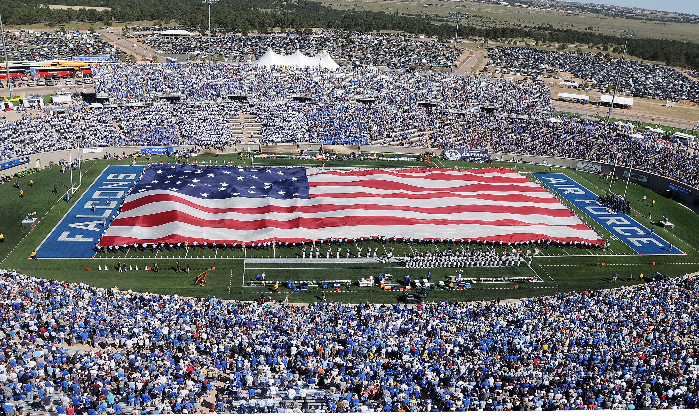
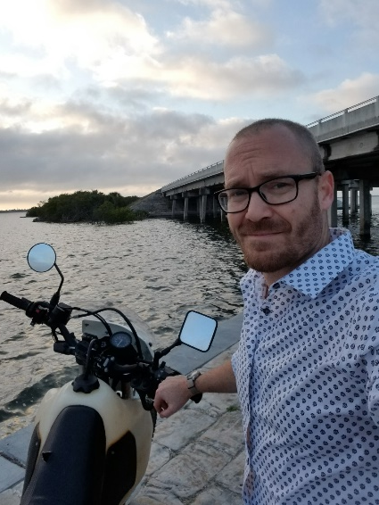
#Peopleware
Notes:
The most enchanting and inspiring thing about our ideas, or programs, and our eye-watering digital technology is that they all lead us to our people. HASH-TAG PEOPLEWARE!
Peopleware is by far the most powerful set of algorithms in the universe. And I assure you, there is endless peopleware being created around the globe 24/7/365.
We are swimming in talent, in all DoD Services, and across academia and our private and commercial sector partners.
My charge to all of you is to SEE them, to KNOW them and to deliberately develop them on a path to digital greatness.
The mission of the USAF is to fly, fight and win in air, space and cyberspace.
Our technology can fly autonomously, it can even fight autonomously with the right policy and authorities, but ultimately, I believe beyond a shadow of a doubt that only YOU can deliver the Win.
And in our business ladies and gentlemen, Losing is not an option!
Behold, the power of us!

