Slide 1
Regional, Scalable, Low-Cost Robotics Programs Pikes Peak Robotics AFCEA Luncheon
Erik Huffman and Nat Sobin
May 18, 2022
AFCEA Luncheon – Jack Quinn’s

Slide 2
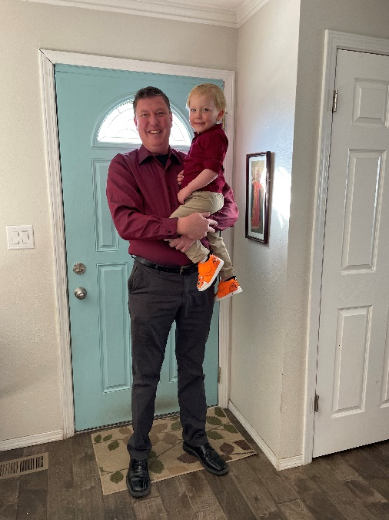
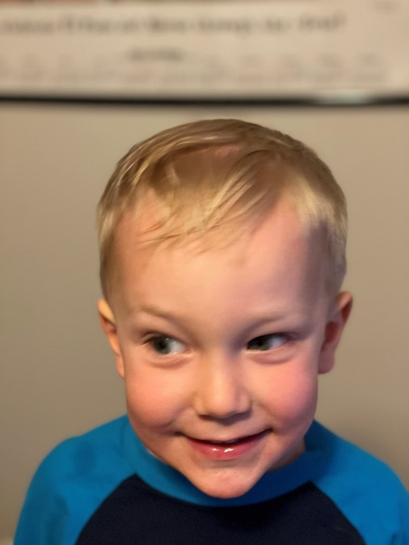
A very brief introduction…
I am Nathaniel (Nat) Sobin
Coordinator of Grants and STEM Programming (WSD3) in Colorado Springs
Manage DoDEA grants (2017/2019), CDE CS grants, our district’s PLTW/STEM programs and secondary robotics for our district and region
Serve as President (outgoing) of CACTE ETMA, ACTE ETED Policy Board, (incoming) Program Lead for DoDEA Region V Lead, Executive Director / Co-Founder of PPR
My background is in structural engineering, design and construction – dissertation in evaluation capacity for alternative fuel deployment programs
My man is Merrick Sobin (my now 3-year old)

Slide 3
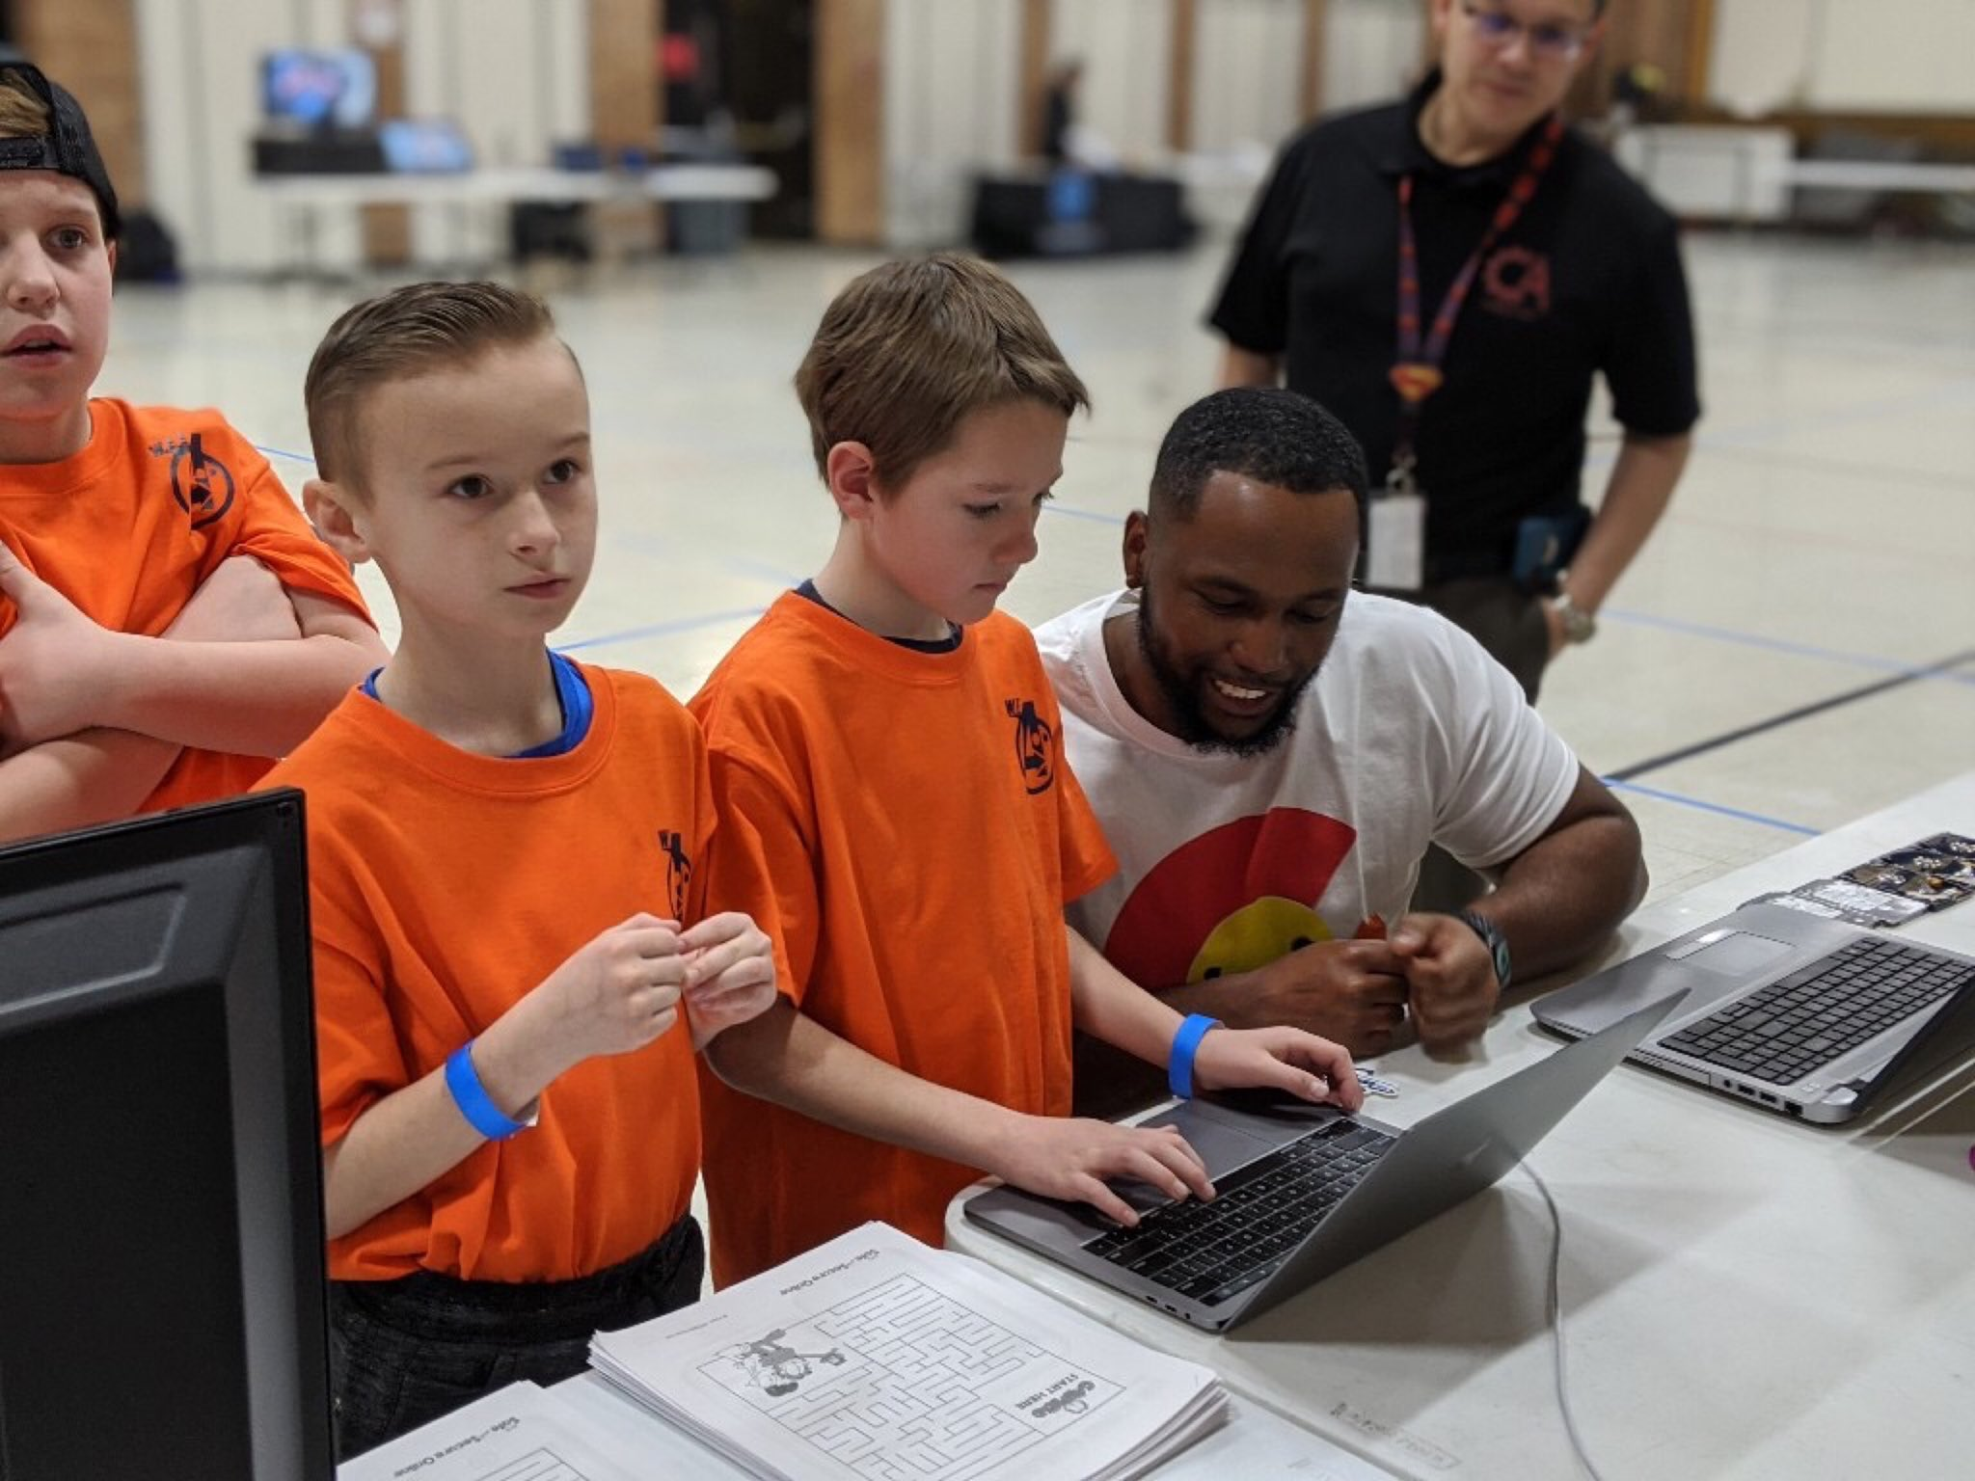
A very brief introduction…
I am Erik Huffman
IT and Cybersecurity Director at BombBomb
Cybersecurity and cyberpsychology researcher
Serve as President (outgoing) of Pikes Peak Robotics, former member of the BARSL for US Army
My background is in cybersecurity

Slide 4
Agenda
Brief introduction on robotics, robotics platforms and what age groups they serve
How to think about which robotics programs are out there (why we use the one we use)
Pikes Peak Robotics - a regional robotics program that simultaneously serves multiple districts
Our programmatic successes from this year and where we’re headed
Presentation Format: A few graphics and hierarchy slides discussion, contact information and resources (please ask any questions as they arise) ☺

Slide 5
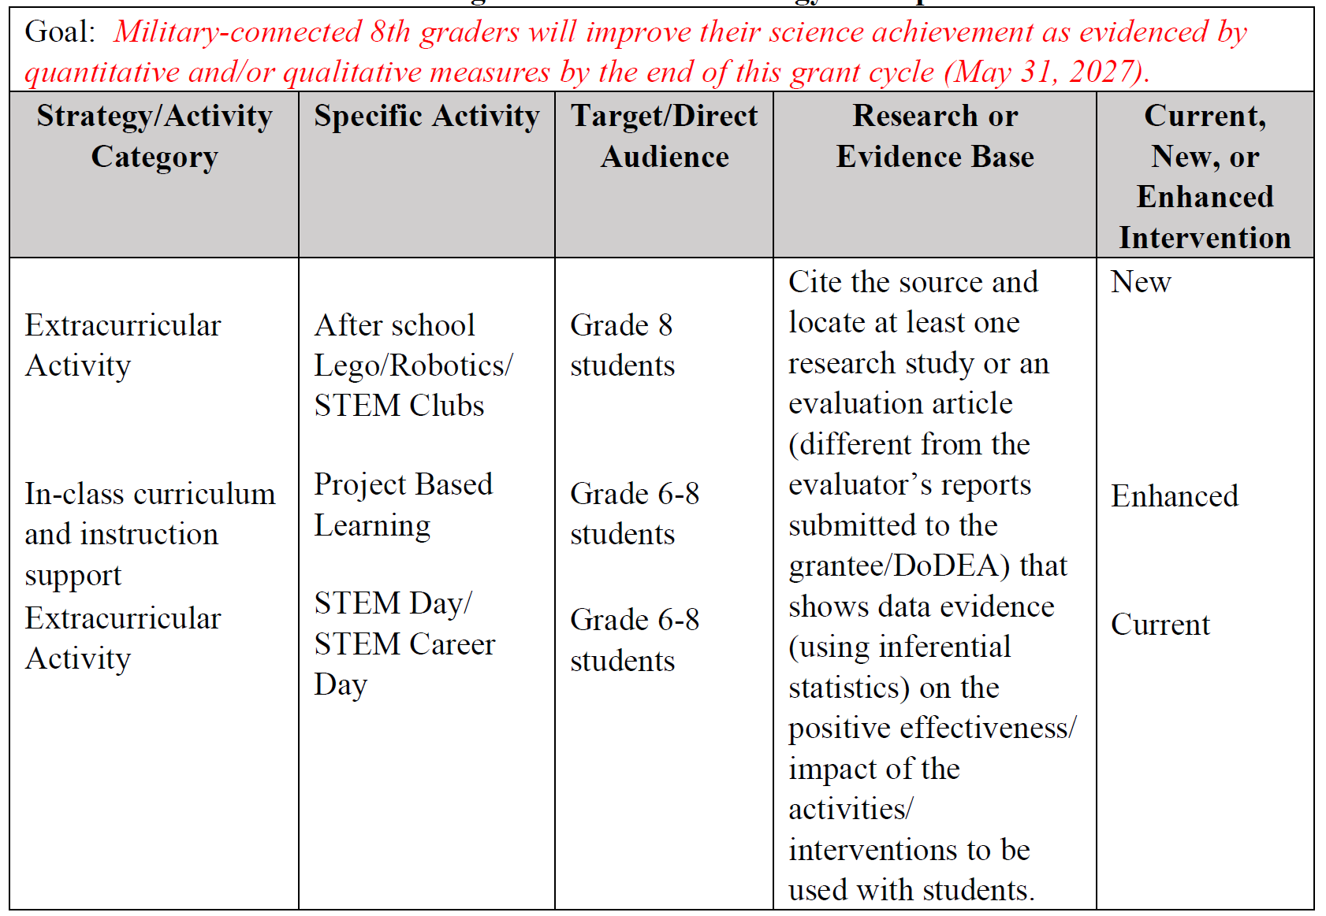
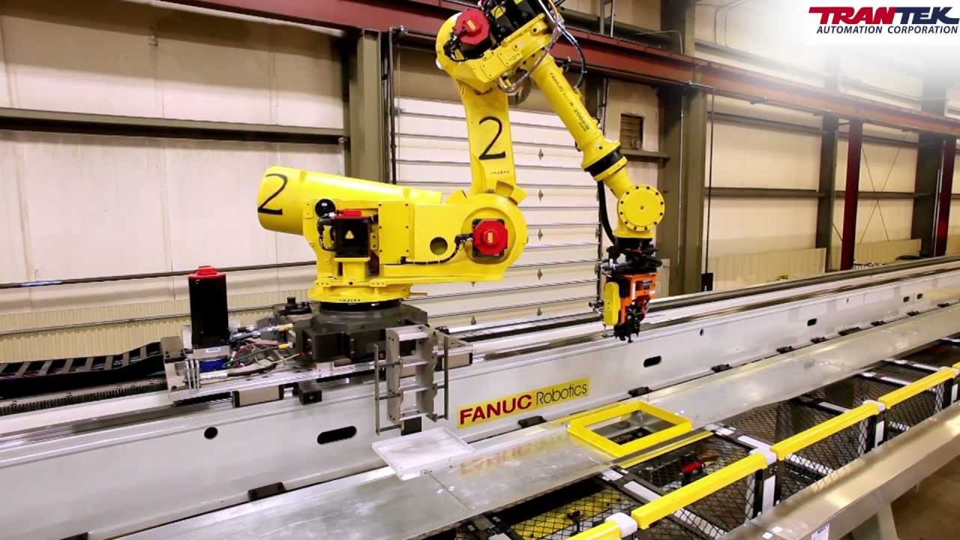
Why robotics as a topic?
Robotics is very common theme/need in nearly all programs
Robotics is a 21st century skill that all need exposure to (not necessarily expertise)
Building a comprehensive, well-planned program is a major part of grant sustainability – CTE, CTSOs & Career Pathways

Slide 6
Robotics – K-NASA (what’s out there…?)
Lego Mindstorm
(Grades K-5)
VEX IQ
(Ages 8-14)
VEX VRC (v5)
(MS and HS – Grades 6-12)
BEST Robotics
(MS and HS – Grades 6-12)
First Lego League
(Grades K-5)
First – First Technical Challenge (FTC)
(MS and HS – Grades 6-12)
First Robotics Challenge (FRC)
(HS – Grades 9-12)
Note: The rental car theory…
Battlebots, X-Prize, Robonation, Eng Schools, etc.
(HS/Post-Sec)
NUMEROUS, other proprietary and open-source options (ever evolving…)
Elementary (K-5)
MS (6-8)
HS (9-12)
College/Industry/Pers. Int.
Age/Grade Level

Slide 7
Robotics – Our Version…
Lego Mindstorm
(Grades K-5)
VEX VRC (v5)
(MS and HS – Grades 6-12)
Aligns with PLTW Software/Hardware
First Lego League
(Grades K-5)
Where we want to go in the next 2 years
Exists because of personnel preference
Battlebots, X-Prize, Robonation, Eng Schools, etc.
(HS/Post-Sec)
Elementary (K-5)
MS (6-8)
HS (9-12)
College/Industry/Pers. Int.
Age/Grade Level

Slide 8
Types of Robotics Organization Structures
Pikes Peak Robotics
Regional, Inter-District Level Collaboration
(Grades/Bldgs/District Coordinators)
More Aligned
District Level Collaboration (K-12)
(Multiple Classrooms / Grades /Bldgs / Coordinator)
Grade Levels – Multiple Buildings
(Multiple Classrooms / Grades /Buildings)
Grade Level – Multiple Buildings
(Multiple Classrooms / Grades /Buildings)
Grade Level
(Multiple Classrooms/Same Grade Levels – One Building)
Less Aligned
In-Classroom
(One Class/ One Teacher)
Less Collaborative
More Collaborative

Slide 9
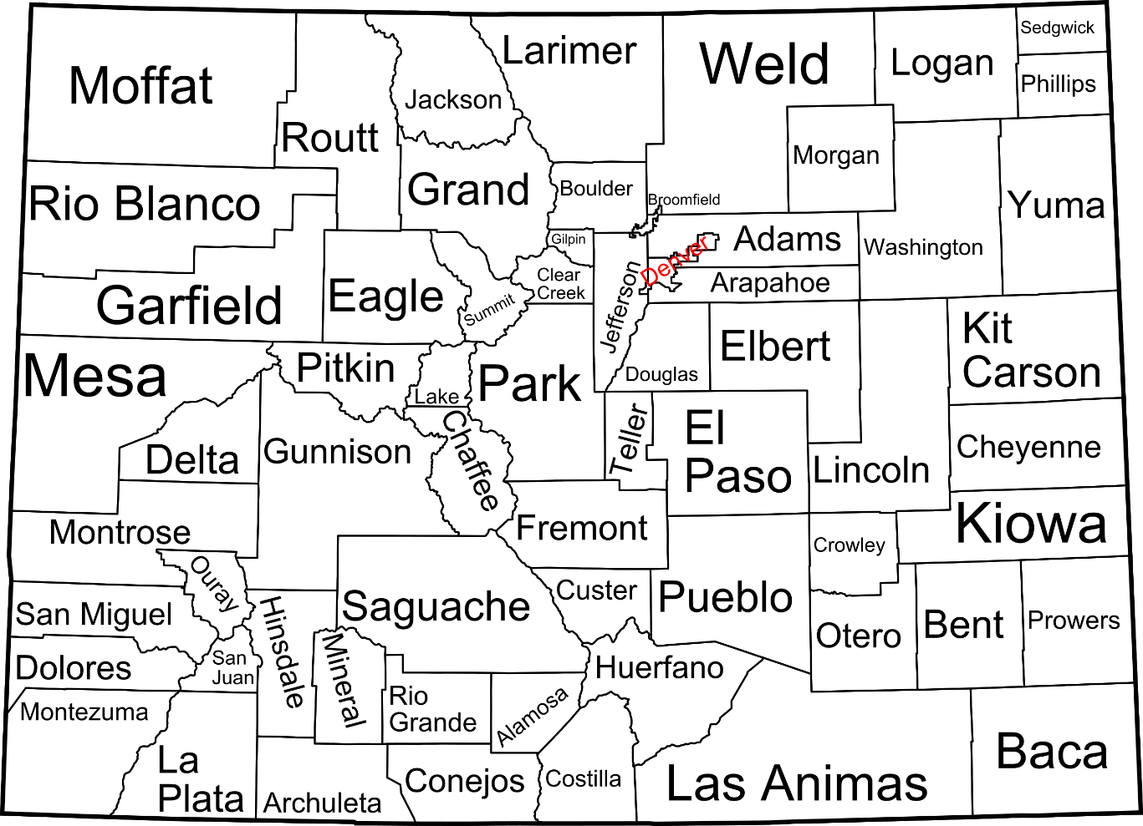
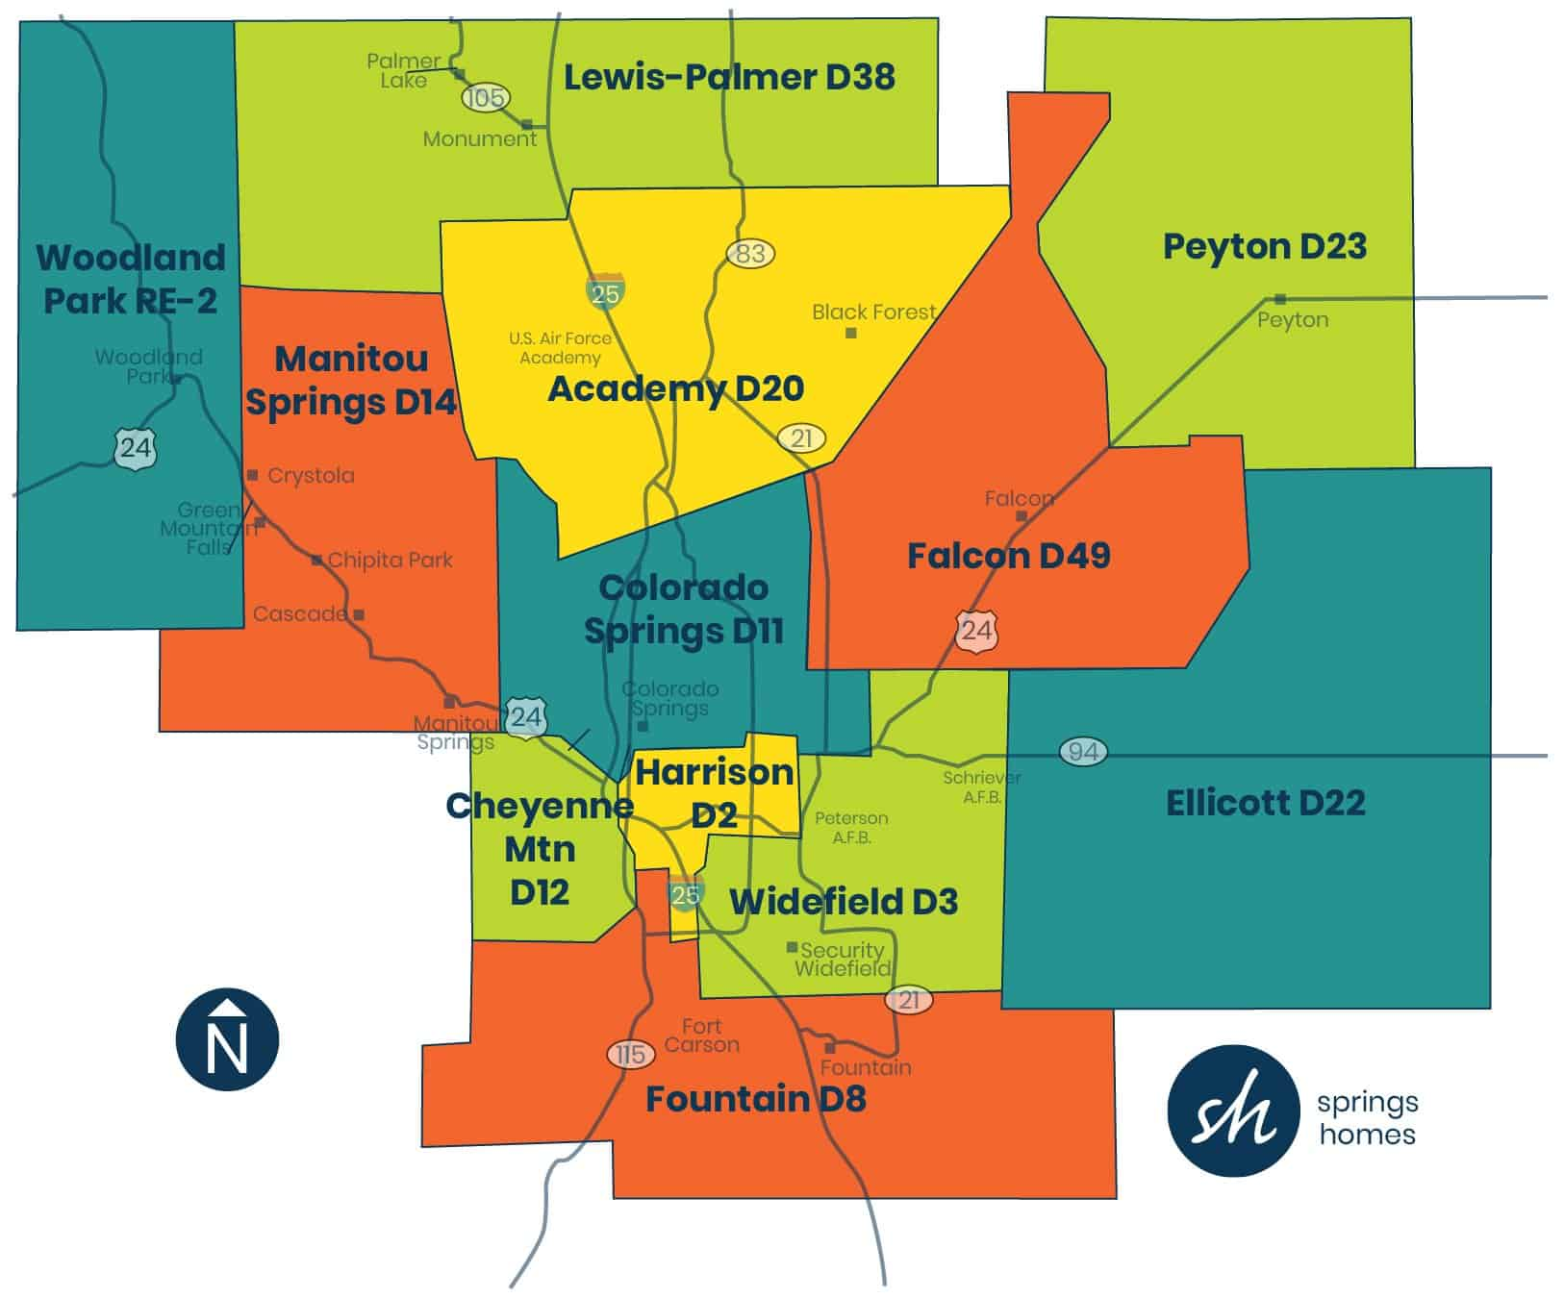
A Case Study – Pikes Peak Robotics

Slide 10
Pikes Peak Robotics – (this year…)
(4) Events in VEX VRC – including the 2 largest events in Colorado
Hosted State Championship
Had (2) teams qualify for VEX Worlds…
Partners and Sponsors
Northrop Grumman
Colorado Springs Utilities
FedEx
Space Force
Department of Defense Education Activity (DoDEA)

Slide 11
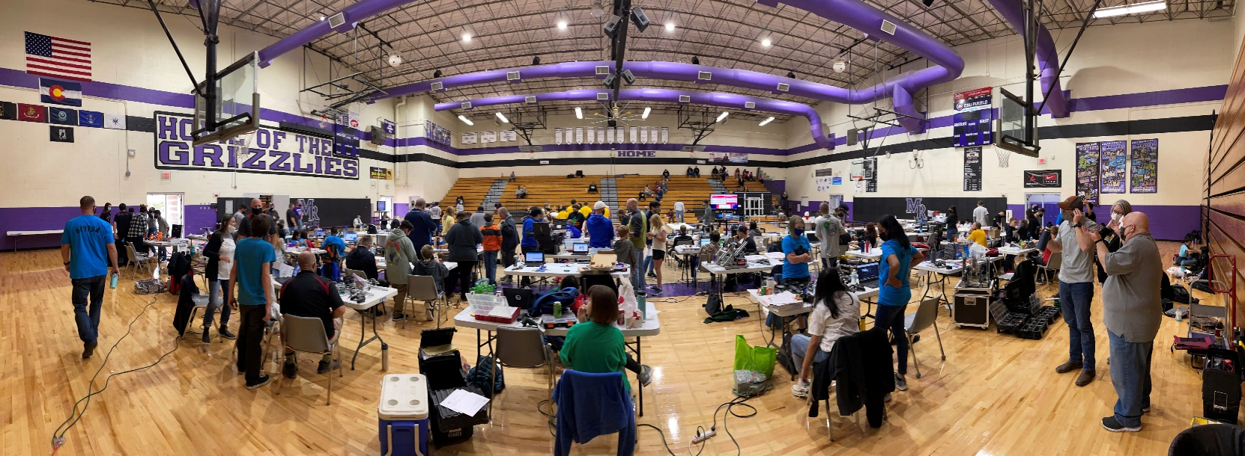
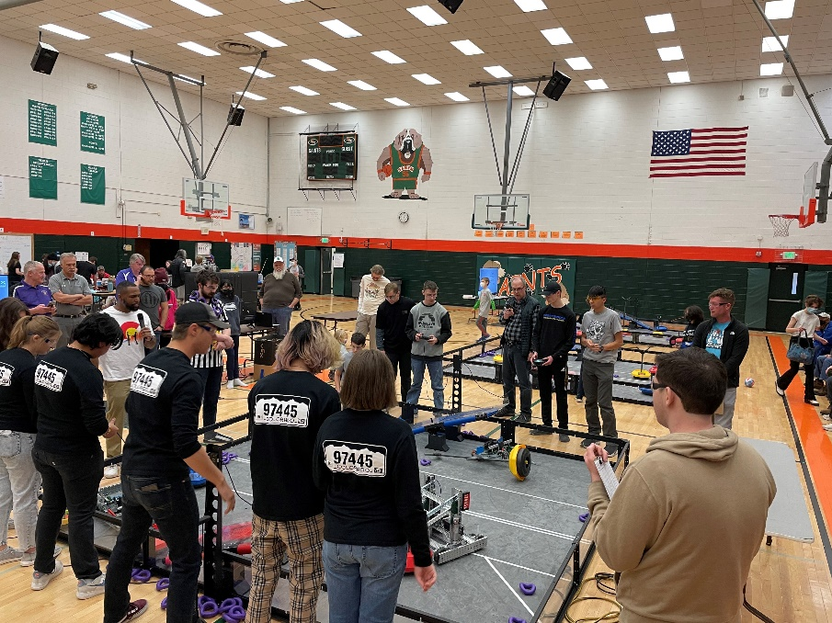
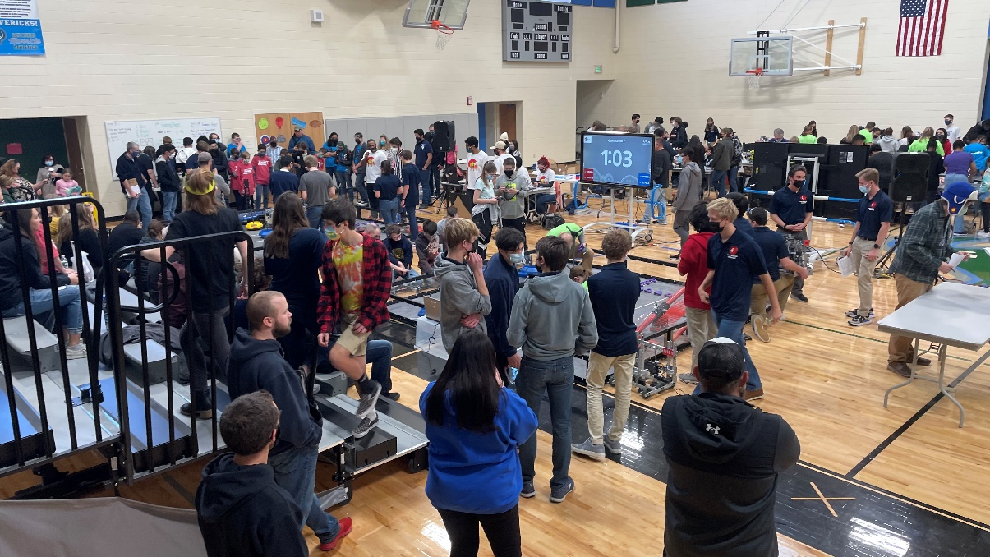
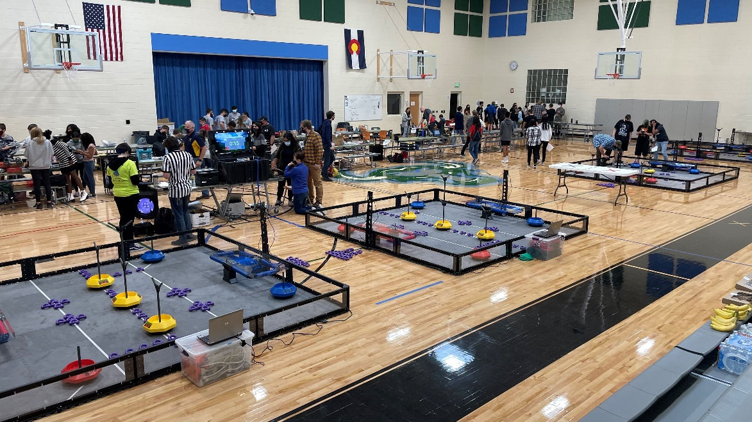

Slide 12
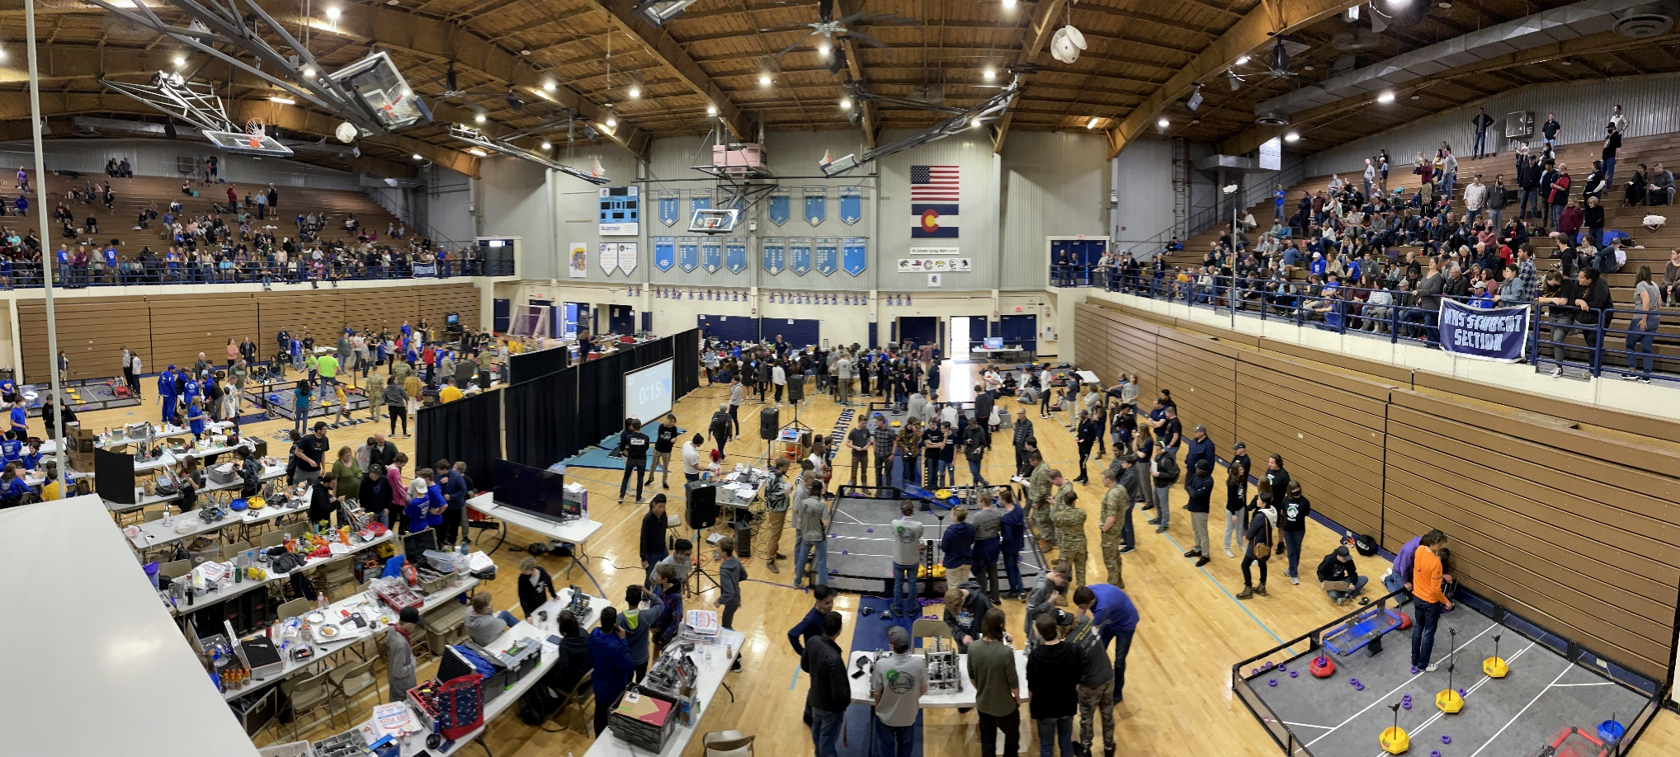
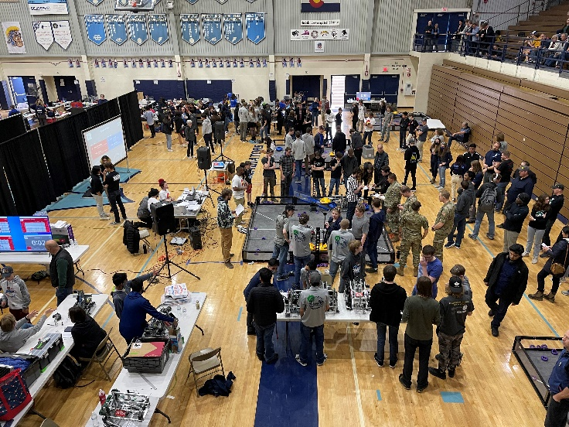
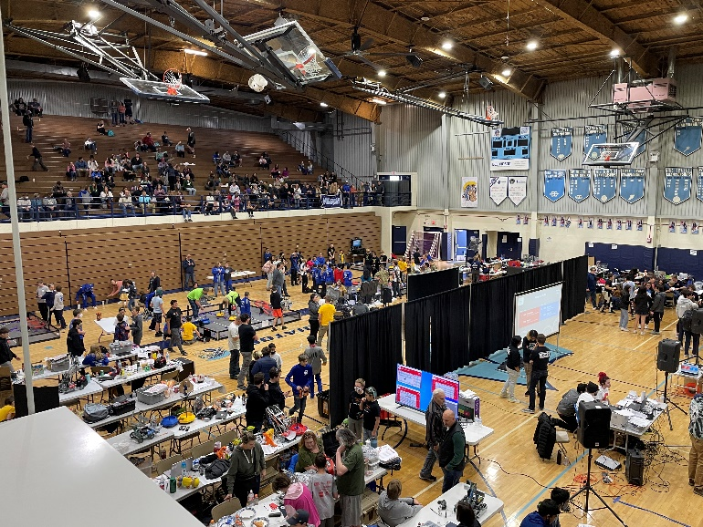

Slide 13
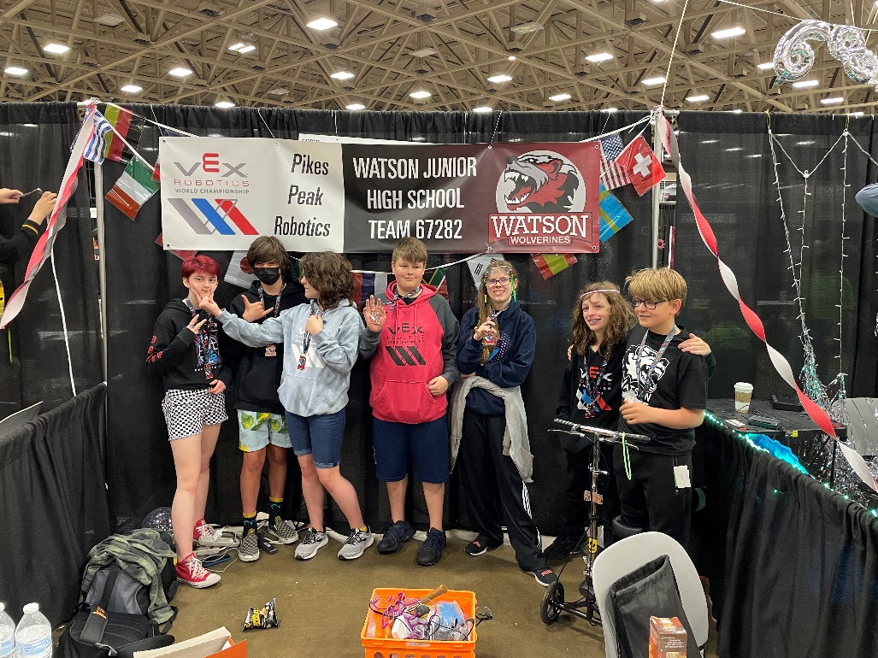
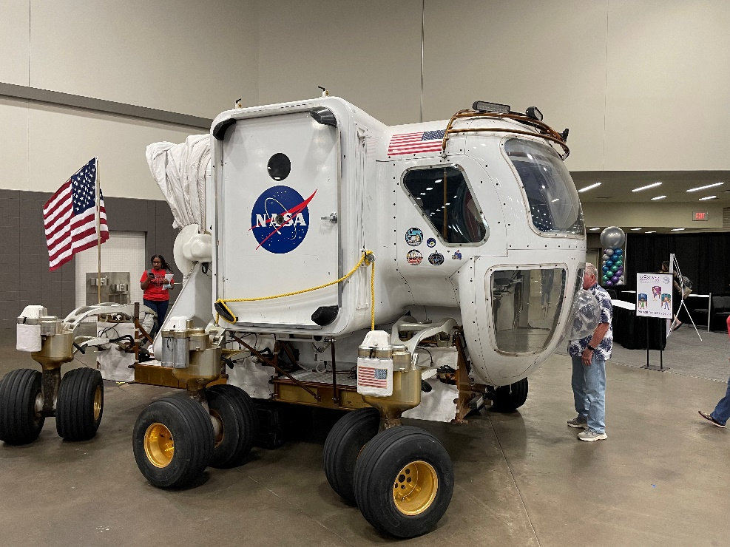
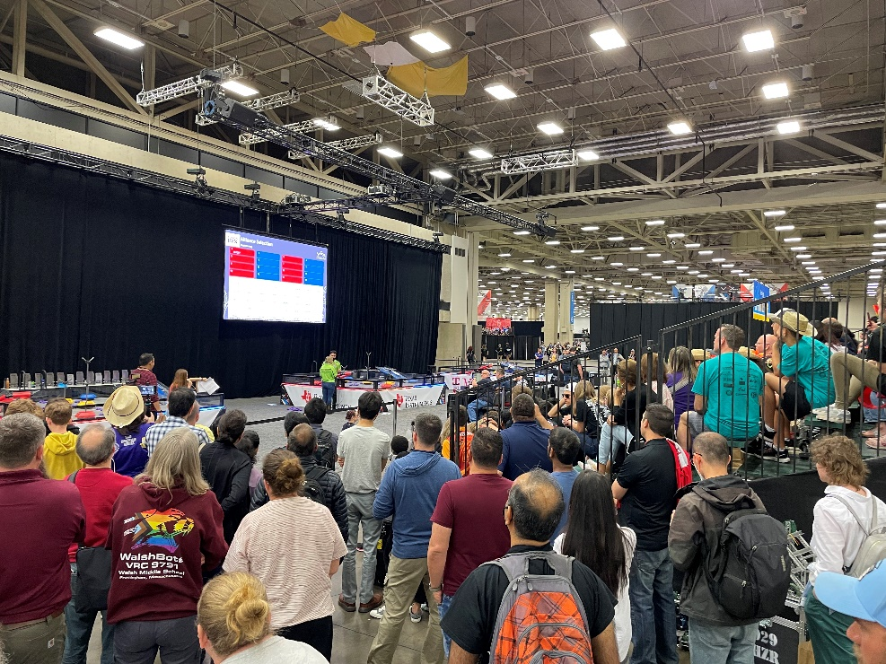
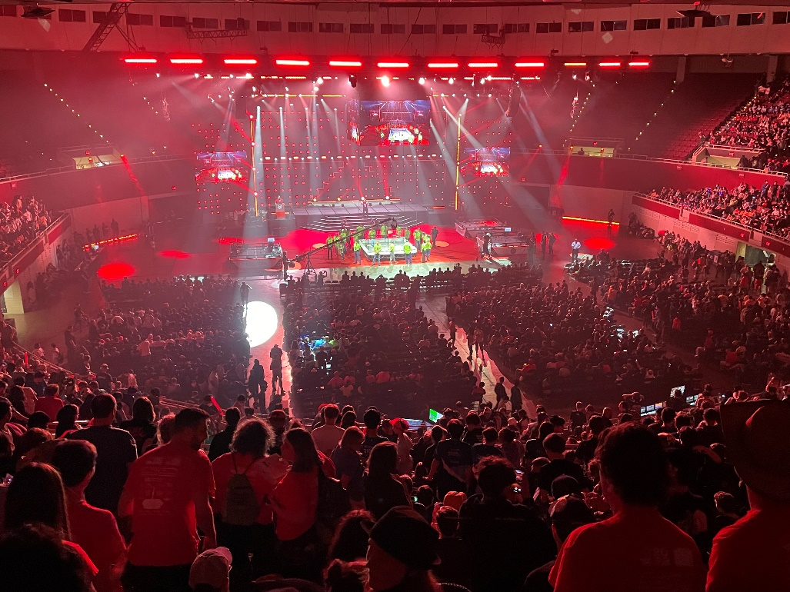

Slide 14
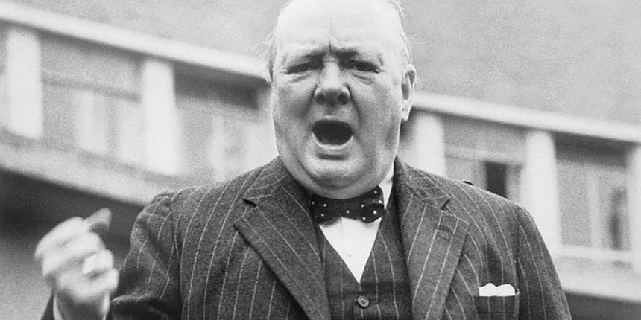
What’s next…
Land, Air and Sea Robotics!
10/8/22 Scrimmage – Mesa Ridge High School (MRHS) – WSD3
11/12/22 – Scored Qualifying Event – Mesa Ridge High School (MRHS) – WSD3
12/10/22 - Scored Qualifying Event – Vista Ridge High School (VRHS) – D49
1/28/23 - Scored Qualifying Event – Sabin Middle School (VRHS) – D11
2/20-23/23 – VEX VRC Signature Event – Broadmoor??
3/23 – SeaPerch (augmented) – Underwater Robotics

Slide 15
Our partners, our support group and our thanks!
Department of Defense Education Activity (DoDEA)
Colorado Springs Utilities (CSU) – Susan Barnas and crew
FedEx – Susan and Jeff Forget and crew
Air Force/Space Force – Victor Chavez and crew
Northrop Grumman – Regional grant support
ActionWorks – Ken and Liz Rayment
Handshake Leadership – Erik Huffman and crew
CTE Directors of the region – Duane Roberson (D11)
And…AFCEA ☺

Slide 16
Call to Arms…

Slide 17
Questions, Discussion & Contact Information
Helpful Links:
www.robotevents.com
www.pikespeakrobotics.org (under revision)
https://www.roboticseducation.org/
https://www.roboticseducation.org/team-resources/grants/
https://vr.vex.com/

Slide 18
Questions, Discussion & Contact Information
Erik Huffman
President of Handshake Leadership / Pikes Peak Robotics
erik.huffman@handshakeleadership.com
719-244-0149
Nat Sobin
Coordinator of Grants and STEM Programming
Widefield School District 3
Executive Director of Pikes Peak Robotics
sobinn@wsd3.org
719-761-6782

