Slide 1

Welcome!
26 August 2022
AFCEA Guest Speaker & Happy Hour Event
Guest Speaker & Host:
Ms. Gretchen Bliss
UCCS Director of Cybersecurity Programs

Slide 3
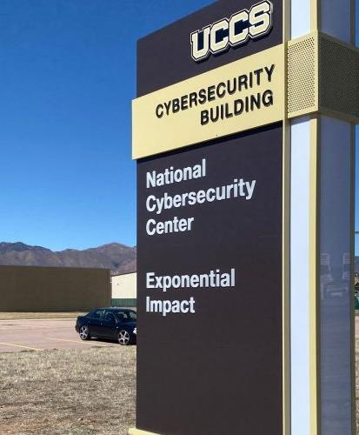
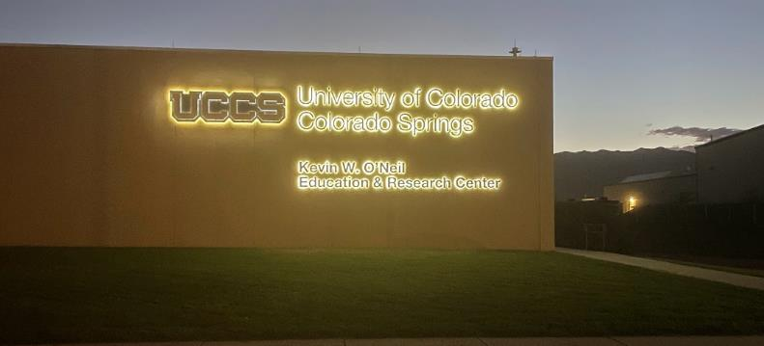

Slide 4
Cybersecurity at UCCS
Multiple organizations with one mission
Welcome
AFCEA
Gretchen Bliss
UCCS Director of Cybersecurity Programs

Slide 5
UCCS Cybersecurity Timeline
2020 – NSA National Faculty Development lead
2020 – NSA Northwest Hub Lead –10 states
2021 – Space ISAC IOC
2021 – CoB, LAS and SPA cybersecurity programs begin
2017 – National Cybersecurity Center - NCC
2014 – NSA CAE Designation
2008 - EAS Cybersecurity degrees (BS, ME, and PhD)
2020 – DoL CCAP grant – Cybersecurity Apprenticeships
2022 – UCCS Kevin W O’Neil Cybersecurity Education and Research Center Building
2018 – State funding for programmatic buildout
2016 – Began initial building renovation - habitability

Slide 6
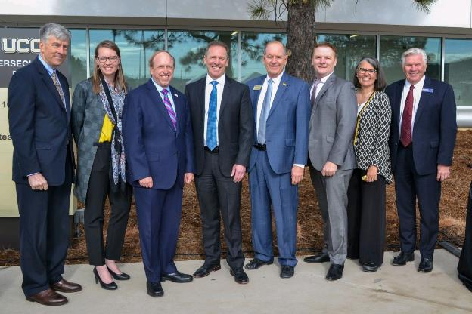
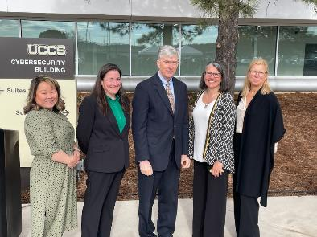
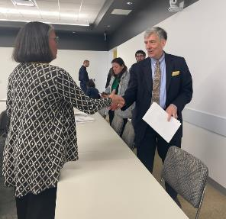
UCCS Cybersecurity Building Opening 5 May 2022

Slide 7
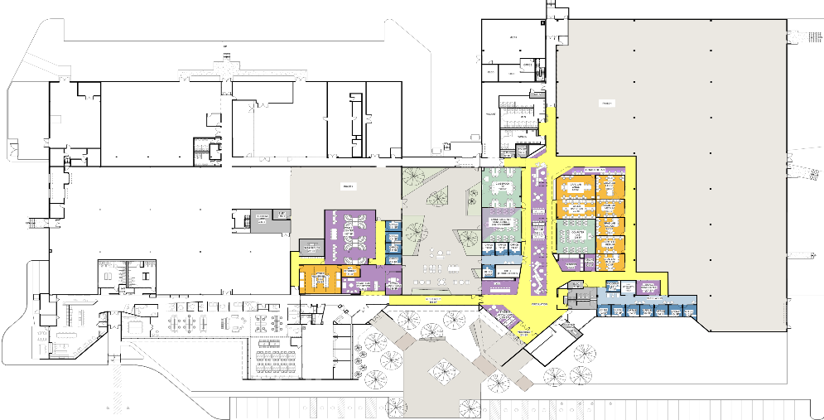
Phase 4 Cyber Renovation
Conference Space,
Classroom, Cyber-Range
Student Research
Space (CS/Bus/SPA)
Business and SPA
Office Suite
CS Office and Lab Expansion

Slide 8

Cybersecurity Strategy
Partnership
Outreach
Workforce Development
Education
Research
Each effort has strategic goal, focus areas, and initiatives
Dynamic, ongoing coordinated

Slide 9
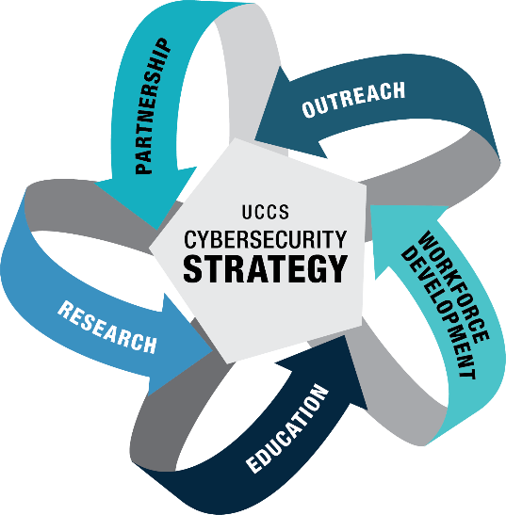
Cybersecurity Strategy
Multidisciplinary approach
Cybersecurity Program Office
College of Business
College of Education
College of Public Affairs
College of Engineering and Applied Science
College of Letters, Arts and Sciences
UCCS Administration
UCCS Student Services
UCCS Admissions
UCCS OIT
NCC
Space ISAC
UCCS Outreach

Slide 10

UCCS POWER Cybersecurity Strategy
Core Principles:
  Diversity
  Excellence
  Multi/Cross-disciplinarity

Slide 11
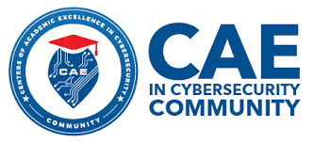

UCCS – Center of Academic Excellence in Cybersecurity
Redesignating CAE-CD
Exploring CAE-R and CO
CAE Northwest Hub PI
CAE Faculty Development PI
CAE Competency Exercise
CAE Competitions
Community of Practice CAE- CD
GenCyber
  5 middle school camps across Colorado 2021
  2 teacher camps and 3 student camps 2022

Slide 12


UCCS Cybersecurity
UCCS WiCyS Student Chapter
  K-12 outreach
  WiCyS Fireside Chat Series w/ Tanium – 3 CU locations
WiCyS Industry Affiliate
  Based in Denver
WiCyS International Annual Conference
  2020-2021 Gaylord Rockies Resort Denver CO
    UCCS lead of local support team
  2023 returning to Gaylord Rockies Resort Denver CO
  UCCS academic sponsor – 2021, 2022, and 2023

Slide 13

Mountain West Cybersecurity Consortium
8 state region – CO, NM, AZ, UT, WY, ID, MT, and NV
Over 27 organizations and 100 members
Vision- To foster the Mountain West as a preeminent region for cybersecurity by influencing the efforts of the area's higher-education institution
Mission
  Foster collaboration between the Mountain West higher-education institutions in Research, Workforce Development, and Education.
  Partner with both public and private organizations to understand and address their needs for cybersecurity.
  Facilitate outreach to the K-12 schools in the region.
  Educate the cybersecurity workforce of tomorrow.
  Diversify the cybersecurity workforce in order to address the broad range of needs in the field.

Slide 14

Colorado State Cybersecurity Funds
21 Projects across colleges
EAS - Student Empowerment in Cybersecurity
EAS - Team Collaboration in Cybersecurity: The Development of a Skill Building Workshop
SPA - Understanding the Social & Behavioral Role in Cybercrime & Cybersecurity
CoE - Campus Connections: Cultivating Social and Emotional Wellness in At-Promise Youth through Digital Citizenship
LAS - Enhancing Digital Leadership for Student Affairs and Higher Education Professionals
LAS - Developing Language and Cultural Literacy Skills to Address Strategic Diversity Needs in Cybersecurity
Marketing - National Cybersecurity campaign
STEM educational outreach - Cybersecurity Middle School Camps
STEM Educational research - Cyber Girls - Middle School Camp
Library - O'Reilly for Higher Education Subscription

Slide 15

Who Makes a Good Cyber Student?
Wants to do good in the world
Strong moral compass
Problem solver
Constant learner
Adaptable to change
Confident
Creative
Fast learner
Critical thinker
Team oriented

Slide 16
Many Diverse Pathways to Cybersecurity
Program of Study
Business
EAS
Education
Liberal Arts
Finance
Military
Law, Criminal Justice
Media & Comms
Public Affairs
Health Sciences, Healthcare
Inclination
Create
Build
Secure
Operate
Defend
Protect
Analyze
Diagnose
Test
Refine
Document
Tech Skills or Interests
IT/Tech
Software Development
Databases, Data Analytics
Networking
Tech-adjacent Skills
Cybersecurity
Notes:
Auditing / Investigate

Slide 17
How: Cybersecurity Degrees/Pathways at UCCS
Colleges of EAS, Business, Public Affairs, LAS
PhDs: Computer Science, Security
Executive DBA: Cybersecurity Management
ME: Cybersecurity, Information Assurance
MS: Computer Science
MBA: Cybersecurity Management
BS & BA: Computer Science
BS: Computer Engineering
Bachelors of Innovation: Comp. Science Security
BS: Cybersecurity Management
UG Certificates: Applied Cybersecurity, Network Systems Security, Engineering Secure Software
Grad Cert: National Security Intel, Homeland Security
Certificate: Cybersecurity Management
Option Area: Cybercrime and Cybersecurity
Concentration: Cybersecurity Track, Tech Comms & Info. Design Program
Focus: Interdisciplinary Studies Cybersecurity Liberal Arts
Notes:
Also have Articulation agreements with PPCC, ACC, PCC from their Associate Cyber degrees to UCCS Bachelors of Computer Science
ME: Master of Engineering
Colleges of Education and Nursing have cyber covered in their courses,
Comp. Sci, while not directly cyber – you can choose the cyber track (or other related tracks like AI/ML, game design, generic/all, SW eng.)

Slide 18

Colorado Springs Cybersecurity Ecosystem Partners
NSIN - National Security Innovation Network
NSA
National Renewable Energy Lab - NREL
Peterson
Schriever
Space Force
Small Business Development Council (SBDC)
Industry
  Mandiant
  Lockheed Martin
  Tanium
  Deloitte
Community Colleges – PPCC, ACC, PCC – articulated degrees
CU System Cybersecurity Clubs
Women in Cybersecurity (WiCyS)
  Student Chapter
  Industry Affiliate
Mountain West Cybersecurity Consortium
National Cybersecurity Center
Space ISAC
Catalyst Campus – CCTI
ISSA
AFCEA
USAFA
  Cyber Worx
  Academic programs

Slide 19
Ecosystem Activities
Community Events
Cyber First Fridays – Colorado Springs Chamber/Murray Security Services
Cool Science – UCCS partnership with NCC and PPCC
Cybersecurity Leader Roundtable – SBDC
  Cybersecurity hygiene days
Cybersecurity Summit – Colorado Springs Chamber
Annual ISSA Peak Cyber Conference
Annual AFCEA Cyberspace Symposium
Mountain West Cybersecurity Consortium - MWCC
Pikes Peak Business and Education Alliance – high school students
Cybersecurity grant cooperation
  UCCS/NCC/PPCC/ACC/PCC/CCTI
Student/Cadet Cybersecurity Competitions – RMCCDC/NCL/Cyber Force/Pikes Peak Cyber Challenge w Deloitte
Student Career panels/internships/mentoring

Slide 20
Questions?
Next Up:
Ms. Erin M. Miller
Executive Director, Space ISAC

